Slide 1
Java operators and conditional statements

Slide 2
Operators
Java provides a rich operator environment.
Most of its operators can be divided into the following four groups:
Arithmetic
Bitwise
Relational
Logical
Java also defines some additional operators that handle certain special situations.

Slide 3
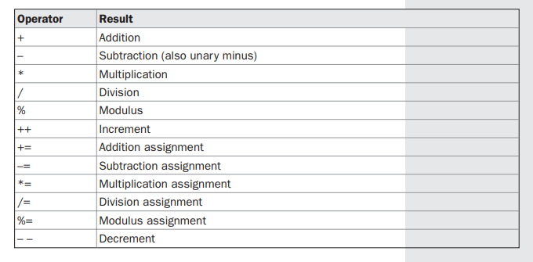
Arithmetic Operators
Arithmetic operators are used in mathematical expressions in the same way that they are used in algebra.
The following table lists the arithmetic operators:

Slide 4
The Basic Arithmetic Operators
The basic arithmetic operations—addition, subtraction, multiplication, and division— all behave as you would expect for all numeric types.
The minus operator also has a unary form that negates its single operand.

Slide 5
To add two numbers
import java.io.*;
class sum{
public static void main(String [] args) throws Exception{
int x,y;
DataInputStream in=new DataInputStream(System.in);
System.out.println("Enter the value of x:");
x=Integer.parseInt(in.readLine());
System.out.println("Enter the value of y:");
y=Integer.parseInt(in.readLine());
System.out.println("The sum of " + x + " and "+ y + " = " +(x+y));
}
}

Slide 6
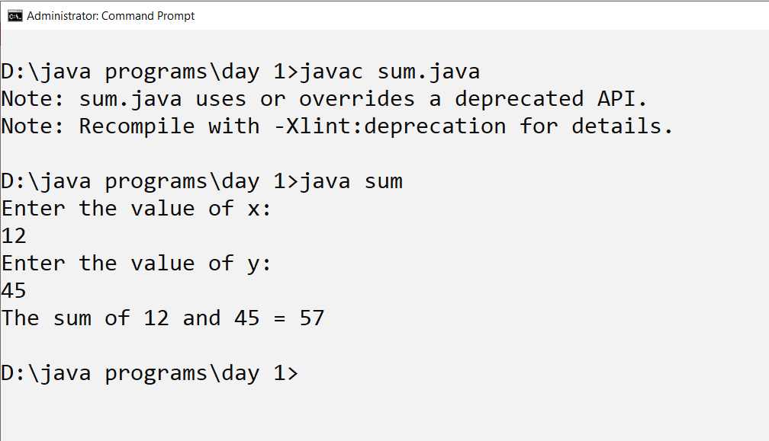
Output, sum of two numbers

Slide 7
Basic arithmetic operations
//program to illustrate the arithmetic operations
class basic_op{
public static void main(String [] args){
int sum=Integer.parseInt(args[0])+Integer.parseInt(args[1]);
System.out.println("The sum="+sum);
int sub=Integer.parseInt(args[0])-Integer.parseInt(args[1]);
System.out.println("The sub="+sub);
int mult=Integer.parseInt(args[0])*Integer.parseInt(args[1]);
System.out.println("The mult="+mult);
int div=Integer.parseInt(args[0])/Integer.parseInt(args[1]);
System.out.println("The quotient="+div);
int neg=-(sum);
System.out.println("The negative sum="+neg);
double divs=Double.parseDouble(args[0])/Double.parseDouble(args[1]);
System.out.println("The double quotient="+divs);
}
}

Slide 8
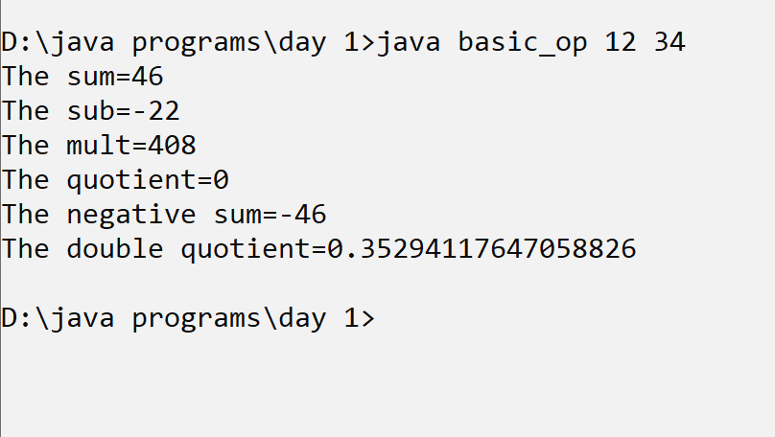
output

Slide 9
/*write a program to inter change two numbers without using temporary variable*/
class swap_without_temp{
public static void main(String [] args){
int x=20;
int y=56;
System.out.println("Before swapping x="+x+" and y="+y);
x=x+y;
y=x-y;
x=x-y;
System.out.println("After swapping x="+x+" and y="+y);
}
}

Slide 10
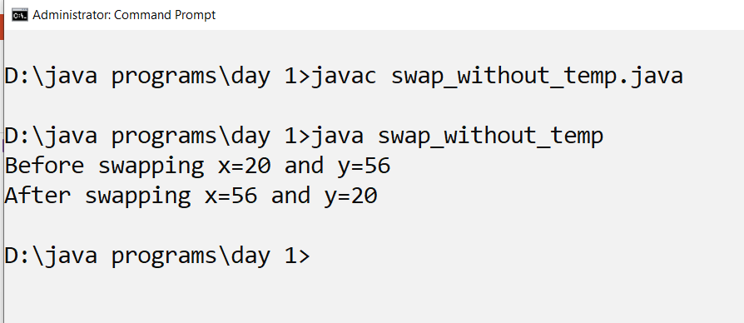
output

Slide 11
The Modulus Operator
The modulus operator, %, returns the remainder of a division operation. It can be applied to
floating-point types as well as integer types.

Slide 12
Arithmetic Compound Assignment Operators
Java provides special operators that can be used to
combine an arithmetic operation with an assignment.
As you probably know, statements like the following are quite common in programming:
a = a + 4;
In Java, you can rewrite this statement as shown here:
a += 4;
Both statements perform the same action: they increase the value of a by 4.
Here is another example,
a = a % 2;
which can be expressed as
a %= 2;

Slide 13
Increment/ decrement operator
The increment operator increases its operand by one.
The decrement operator decreases its operand by one.
For example, this statement:
x = x + 1;
can be rewritten like this by use of the increment operator:
x++;
Similarly, this statement:
x = x – 1
x--;

Slide 14
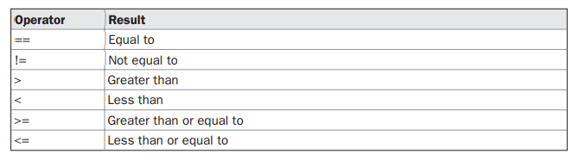
Relational Operators
The relational operators determine the relationship that one operand has to the other.
Specifically, they determine equality and ordering.
The relational operators are shown here:

Slide 15
Java if statements

Slide 16
The if Statement
The if statement is Java’s conditional branch statement.
It can be used to route program execution through two different paths.
Here is the general form of the if statement:
if (condition)
statement1;
else
statement2;
Here, each statement may be a single statement or a compound statement enclosed in curly braces (that is, a block).
The condition is any expression that returns a boolean value.
The else clause is optional.
The if works like this:
If the condition is true,
then statement1 is executed.
Otherwise,
statement2 (if it exists) is executed.
In no case will both statements be executed.

Slide 17
//to find out if a number is divisible by 5
import java.io.*;
class num_mod{
public static void main(String [] args) throws Exception{
DataInputStream in=new DataInputStream(System.in);
int x=Integer.parseInt(in.readLine());
if (x%5==0)
System.out.println("The number "+x +" is divisible by 5");
else
System.out.println("The number "+x +" is not divisible by 5");
}
}

Slide 18
The if-else-if Ladder
A common programming construct that is based upon a sequence of nested ifs is the if-else-if ladder.
It looks like this:
if(condition)
statement;
else if(condition)
statement;
else if(condition)
statement;
.
.
.
else
statement;

Slide 19
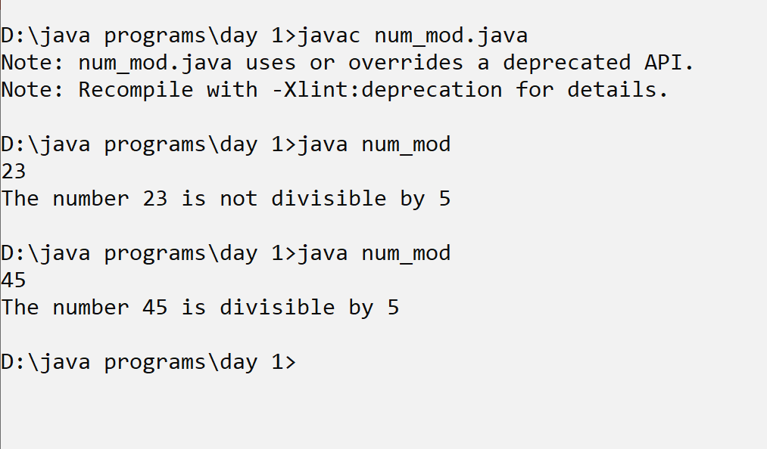
output

Slide 20
To find out whether a number is positive, negative or zero
//to find out whether a number accepted in the command line is a +ve, -ve or zero
class pos_neg{
public static void main(String [] args) throws Exception{
if (args.length==0){
System.out.println("Arguments missing:");
}else{
if (Integer.parseInt(args[0])>0)
System.out.println(args[0] + " is positive");
else if (Integer.parseInt(args[0])<0)
System.out.println(args[0] + " is negative");
else if (Integer.parseInt(args[0])==0)
System.out.println(args[0] + " is zero");
}
}

Slide 21
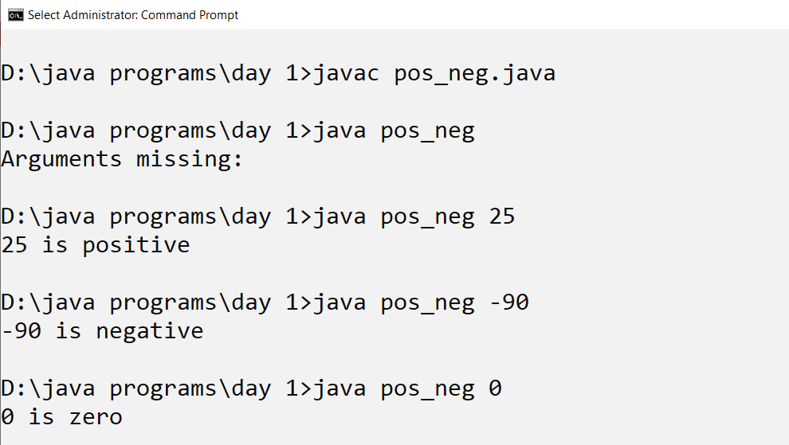
output

Slide 22
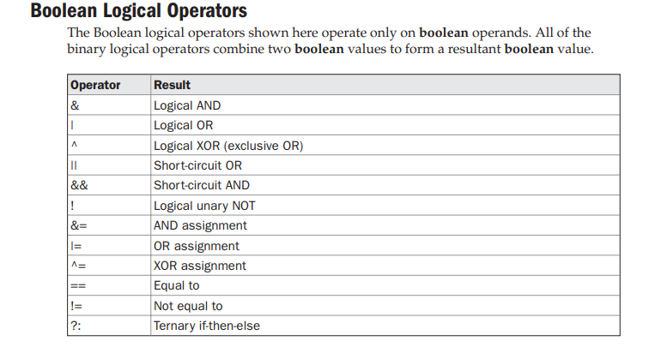
Boolean Logical Operators
The Boolean logical operators shown here operate only on boolean operands.
All of the binary logical operators combine two boolean values to form a resultant boolean value.

Slide 23
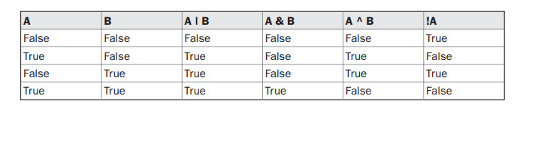
Logical operators
The logical Boolean operators, &, |, and ^, operate on boolean values in the same way
that they operate on the bits of an integer.
The logical ! operator inverts the Boolean state:
!true == false and !false == true.
The following table shows the effect of each logical operation

Slide 24
/* to find the largest number from 3 numbers*/
class largest{
public static void main(String [] args) throws Exception{
int x,y,z;
DataInputStream in=new DataInputStream(System.in);
System.out.println("Enter the value of x:");
x=Integer.parseInt(in.readLine());
System.out.println("Enter the value of y:");
y=Integer.parseInt(in.readLine());
System.out.println("Enter the value of z:");
z=Integer.parseInt(in.readLine());
if (x>y && x>z)
System.out.println("X is largest");
else if (y>z && y>x)
System.out.println("Y is largest");
else if (z>y && z>x)
System.out.println("Z is largest");
}
}

Slide 25
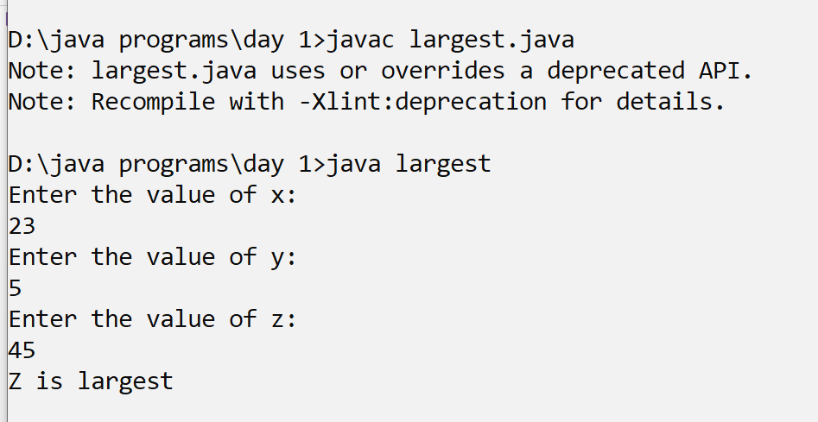
output

Slide 26
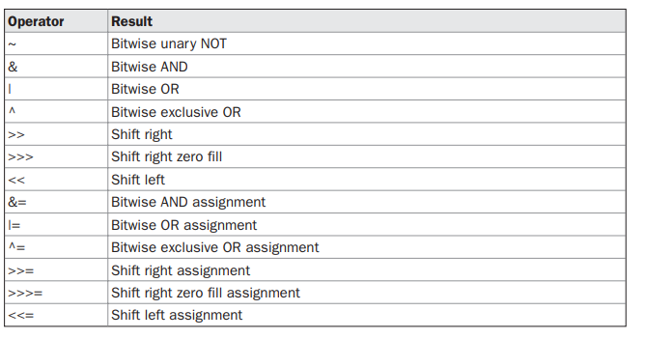
The Bitwise Logical Operators
The bitwise logical operators are &, |, ^, and ~.
The following table shows the outcome of each operation.

Slide 27
The Bitwise NOT
Also called the bitwise complement, the unary NOT operator, ~, inverts all of the bits of its
operand. For example, the number 42, which has the following bit pattern:
00101010
becomes
11010101
after the NOT operator is applied.

Slide 28
The Bitwise AND
The AND operator, &, produces a 1 bit if both operands are also 1.
A zero is produced in all other cases. Here is an example:
00101010 (42)
& 00001111 (15)
00001010 (10)

Slide 29
The Bitwise OR
The OR operator, |, combines bits such that
if either of the bits in the operands is a 1, then
the resultant bit is a 1, as shown here:
00101010 (42)
|
00001111 (15)
=
00101111 (47)

Slide 30
The Bitwise XOR
The XOR operator, ^, combines bits such that if exactly one operand is 1, then the result is 1.
Otherwise, the result is zero.
The following example shows the effect of the ^.
This example also demonstrates a useful attribute of the XOR operation.
Notice how the bit pattern of 42 is inverted wherever the second operand has a 1 bit.
Wherever the second operand has a 0 bit, the first operand is unchanged.
You will find this property useful when performing some types of bit manipulations.
00101010 (42)
^
00001111 (15)
=
00100101 (37)

Slide 31
/*write a program to inter change two numbers without using temporary variable*/
class swap_with_xor{
public static void main(String [] args){
int x=20;
int y=56;
System.out.println("Before swapping x="+x+" and y="+y);
System.out.println("Before swapping x="+Integer.toBinaryString(x)+" and y="+Integer.toBinaryString(y));
x=x^y;
y=x^y;
x=x^y;
System.out.println("After swapping x="+x+" and y="+y);
}
}

Slide 32
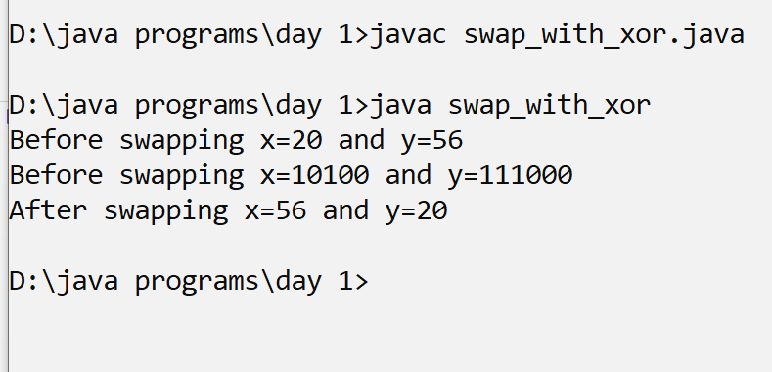
output

Slide 33
The ? Operator
Java includes a special ternary (three-way) operator that can replace certain types of if-then-else statements.
This operator is the ?.
The ? has this general form:
expression1 ? expression2 : expression3
Here, expression1 can be any expression that evaluates to a boolean value.
If expression1 is true, then expression2 is evaluated; otherwise, expression3 is evaluated.
Both expression2 and expression3 are required to return the same type, which can’t be void.

Slide 34
switch
The switch statement is Java’s multiway branch statement
Here is the general form
of a switch statement:
switch (expression) {
case value1:
// statement sequence
break;
case value2:
// statement sequence
break;
.
.
.
case valueN:

Slide 35
To count the number of vowels
import java.io.*;
class switch_vowel{
public static void main(String [] args) throws Exception{
DataInputStream in=new DataInputStream(System.in);
System.out.println("Enter a sentence");
String txt=in.readLine();
int count=0;
for(int i=0;i<=txt.length()-1;i++){
switch(txt.charAt(i)){
case 'a':
case 'e':
case 'i':
case 'o':
case 'u':
count++;
}
}
System.out.println("The number of vowels are:"+count);
}//end main
}//end class

Slide 36
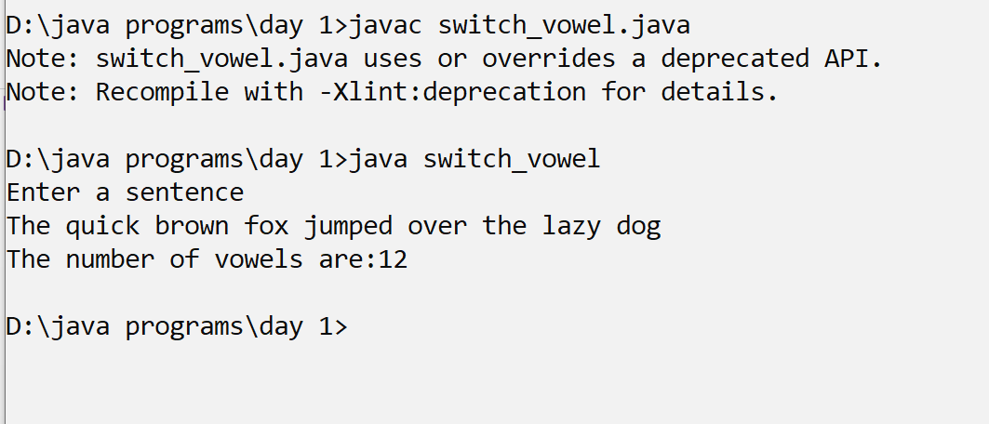
output

Slide 37
Thank you

